Slide 1
What is Application ?
An application is software designed to perform a group of functions, tasks, or activities for the benefit of the user.
Examples of an application includes word processor, web browser, media player etc.

Slide 2
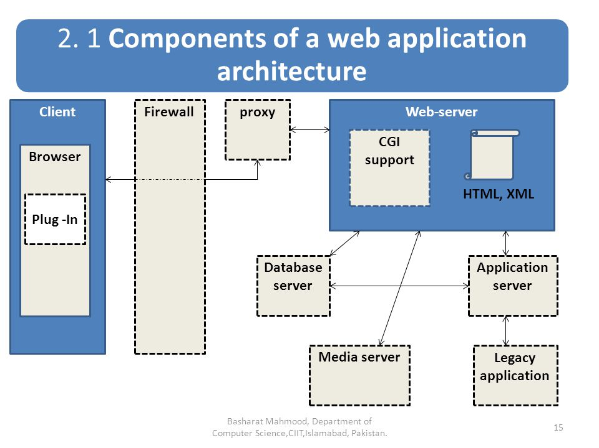
Components of Application

Slide 3
Application Lifecycle Management
ALM is the specification, design, development and testing of a application.
ALM covers the entire lifecycle from the idea conception, through to the development, testing, deployment, support and ultimately retirement of systems.

Slide 4
